Slide 1

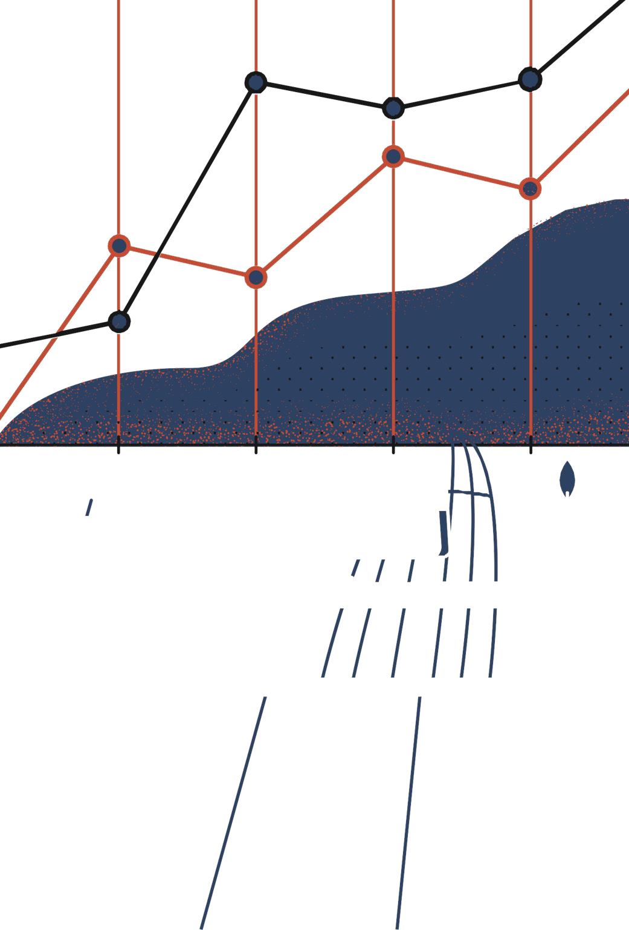

Computer Engineering Department NIT Kurukshetra
B.Tech. Project Report
on
Phishing Website Detection
Under the Supervision of
Dr. Priyanka Ahlawat
(Assistant Professor)
Subhi
(12013021)
Deepak Kumar
(12013071)
Nikhil Kumar
(12013116)

Slide 2

Introduction
Introduction
Phishing is a deceptive cyber attack where attackers impersonate legitimate entities to trick individuals into disclosing sensitive information like passwords or financial details.
The goal of phishing attacks is to exploit human vulnerability by using convincing tactics such as fake emails, websites, or messages to deceive victims.
Phishing techniques continue to evolve with variations like spear phishing (targeted attacks), whaling (targeting high-profile individuals), and clone phishing (replicating legitimate messages) becoming more sophisticated over time.
Nearly 1.2% of all emails shared are malicious, which translates to 3.4 billion phishing emails daily.
Extortion of over 33 million records with a phishing attack or ransomware is expected to occur by 2024.

Slide 3
How to protect User
How to protect User
With the rise in phishing attacks, experts have devised various methods to safeguard users from these types of cyber threats.
Augmenting password logins and multi factor authentication: Augmenting password logins involves strengthening password requirements; Multi-factor authentication adds additional verification steps, like SMS codes or biometrics, to enhance security and prevent unauthorized access.
Black and white list: It is a centralized architecture approach, the URL accessed by user is checked against the predefined list of known phishing or legitimate. First day phishing detection is a challenge with this approach.
Machine learning based approach: Machine learning based approaches leverages the features extracted from the URL and HTML content of webpage to classify page as phishing or legitimate. They are effective in first day phishing detection.
4

Slide 4

Proposed Work
Proposed Work
Our approach involves leveraging machine learning to detect phishing websites, emphasizing the creation of a lightweight yet highly accurate model.
Initially, we extract features from both the URL and webpage content, followed by training these features using nine supervised machine learning models, including Logestic Regression, Naïve bayes, XGBoost, KNN, Decision tree, Random forest, SVM, Stacking classifer and voting classifer.
5

Slide 5
Proposed Work(Continued…)
Proposed Work(Continued…)
The extracted features are categorized into five distinct groups:
JavaScript-based
HTML-based
These features utilize the frequency of the most commonly used attributes and tags.
Hyperlink-based
These features relate to the hyperlinks like the number of external and internal links present.
URL-based
This class encompasses attributes like URL length, presence of special characters etc.
CSS-based
It focuses on the features derived from the CSS used in the HTML, from inline styles and linked stylesheets.
This class pertains to features extracted from the embedded JavaScript code
5

Slide 6
Experimental Details
Experimental Details
Model | Accuracy | Precision | Recall
XGBoost | 99% | 99% | 99%
Logistic Regression | 95.5% | 96% | 96%
Naive Bayes | 79.72% | 81% | 80%
Decision Tree | 97% | 97% | 97%
SVM | 85.6% | 86% | 86%
Random Forest | 98.5% | 99% | 99%
KNN | 93.85% | 94% | 94%
VotingClassifier | 96.1% | 96% | 96%
StackingClassifier | 98.88% | 98.88% | 98.88%
We utilized publicly available dataset obtained from Kaggle.
Dataset consist of 45,373 data points, with 22,687 belonging to the legitimate category and the remaining 22,686 categorized as phishing websites.
XGBoost performed the best with accuracy of 99%, recall of 99% and precision of 99%.
After training we deployed our model on Django backend.

Slide 7
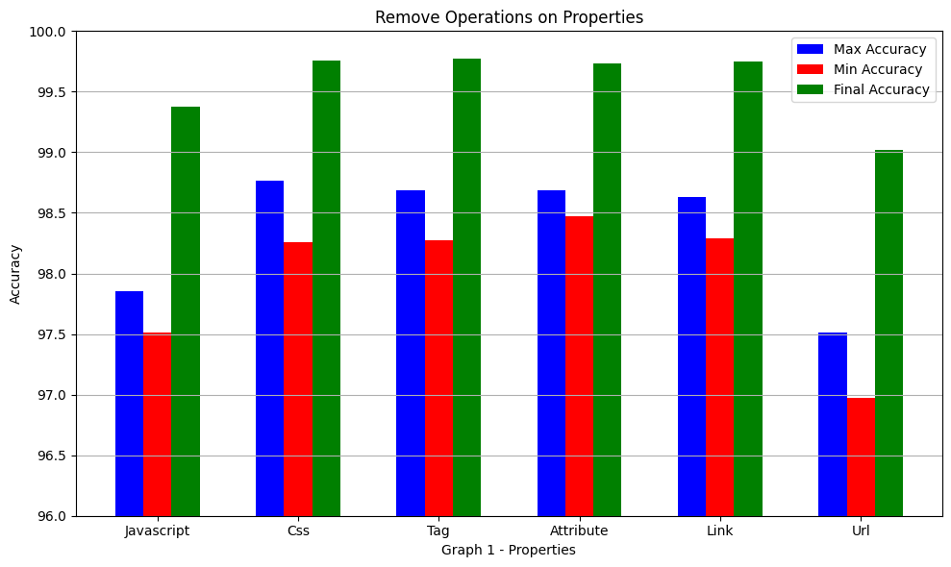
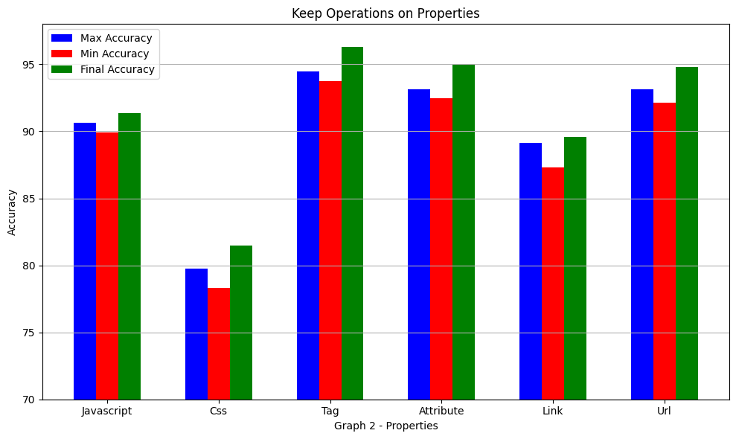
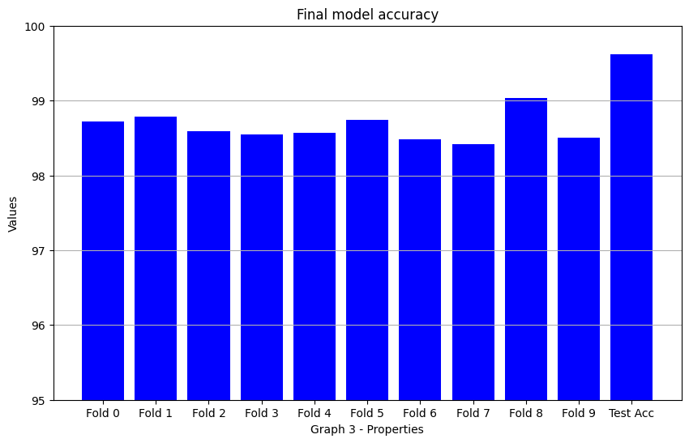
Observation
Observation
Eliminated each type of feature and trained XGBoost model on the remaining features using K-Fold cross validation
Using only one type of feature trained XGBoost model using K-Fold cross validation.
Using all features trained XGBoost model using K-Fold cross validation

Slide 8

The End
THANK YOU!

